Slide 1

Anti-Riot Drone
Autonomous Drones

Slide 2
SOFTWARE USED
MATLAB SIMULINK – USED FOR SIMULATING
QGROUNDCONTROL – FOR DRONE CALIBRATION AND PATH PLANNING
PYCHARMN- For Machine Learning and Deep Learning

Slide 3
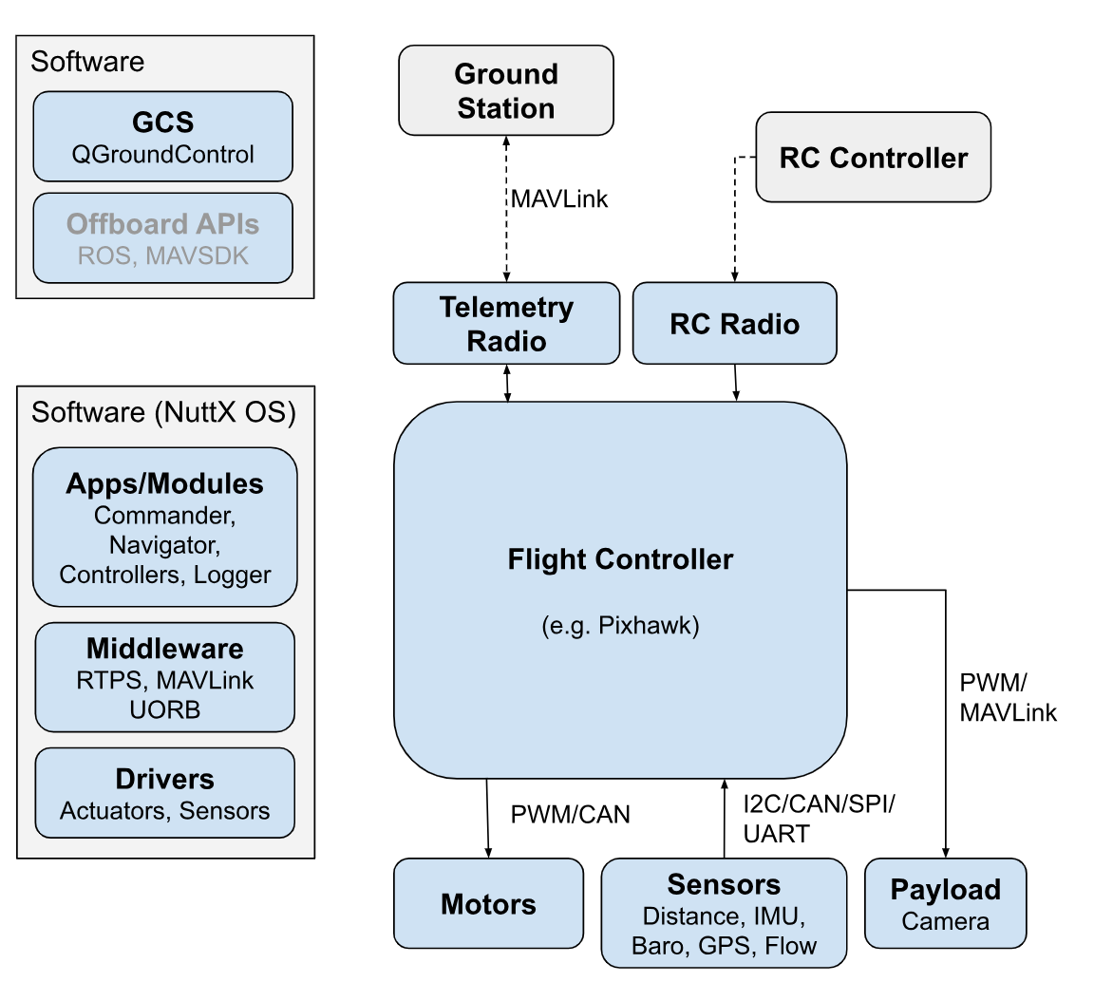
DESIGN OF THE DRONE – ARCHITECTURE OVERVIEW

Slide 4
SENSORS USED
Flight Controller Sensor (IMU): This is a multi-sensor unit combining an accelerometer, a gyroscope, and sometimes a magnetometer.
The accelerometer measures the drone's acceleration in different directions.
The gyroscope measures the drone's rotation rate around its axes.
The magnetometer measures the Earth's magnetic field, helping with orientation.
Together, these sensors provide the flight controller with crucial data to maintain stability and control the drone's position.
Barometer: This sensor measures atmospheric pressure, which can be used to determine the drone's altitude. This is especially important for maintaining a set height during flight.

Slide 5
SENSORS USED
Ultrasonic Sensor: This sensor emits sound waves and measures the time it takes for the echo to return. This allows the drone to determine its distance to obstacles below it, helping to avoid collisions during landing or low-altitude flight.
GPS Module: A GPS module uses signals from satellites to determine the drone's location. This enables features like autonomous navigation and waypoint flying, where the drone follows a pre-programmed path.
Optical Flow Sensor: This sensor uses a camera or light source to track the ground beneath the drone, helping it maintain altitude and position even in environments with weak GPS signals.

Slide 6
ACTUATORS USED
Brushless Motors: These are the workhorses of the drone, responsible for generating thrust. Each motor is connected to a propeller and controlled by an Electronic Speed Controller (ESC).
Electronic Speed Controllers (ESCs): These electronic circuits receive control signals from the flight controller and regulate the power delivered to each brushless motor. By adjusting the power, the ESCs control the speed of the propellers, ultimately determining the thrust generated by each motor.

Slide 7
FLIGHT MODES CALIBRATED
MANUAL MODE
This mode offers complete control over the drone's movement. The pilot directly controls the throttle, roll, pitch, and yaw using the remote control sticks. Used for positioning the drone in the required row while sowing.
ALTITUDE MODE
This mode simplifies altitude control. The pilot controls the throttle for ascent and descent, but the drone automatically maintains a set altitude. This flight mode is used for positioning the drone at appropriate height from the ground while sowing a seed.
LAND MODE
This mode provides safe landing and a controlled descent towards the ground. Used for landing the drone after its

Slide 8
PAYLOAD SPECIFICATION
TEAR GAS DROPPER
Dispensing mechanism: Gravity-fed with a servo-controlled gate
Material: ABS plastic box (lightweight and printable with 3D printing) or plastic cover

Slide 9
PAYLOAD SPECIFICATION
Servo Motor:
Specification: Micro servo with sufficient torque to operate the gate smoothly (e.g., SG90 servo)
Mounting:
Mounting plate design specific to your S-500 frame attachment points
Material: ABS plastic or plywood for rigidity

Slide 10
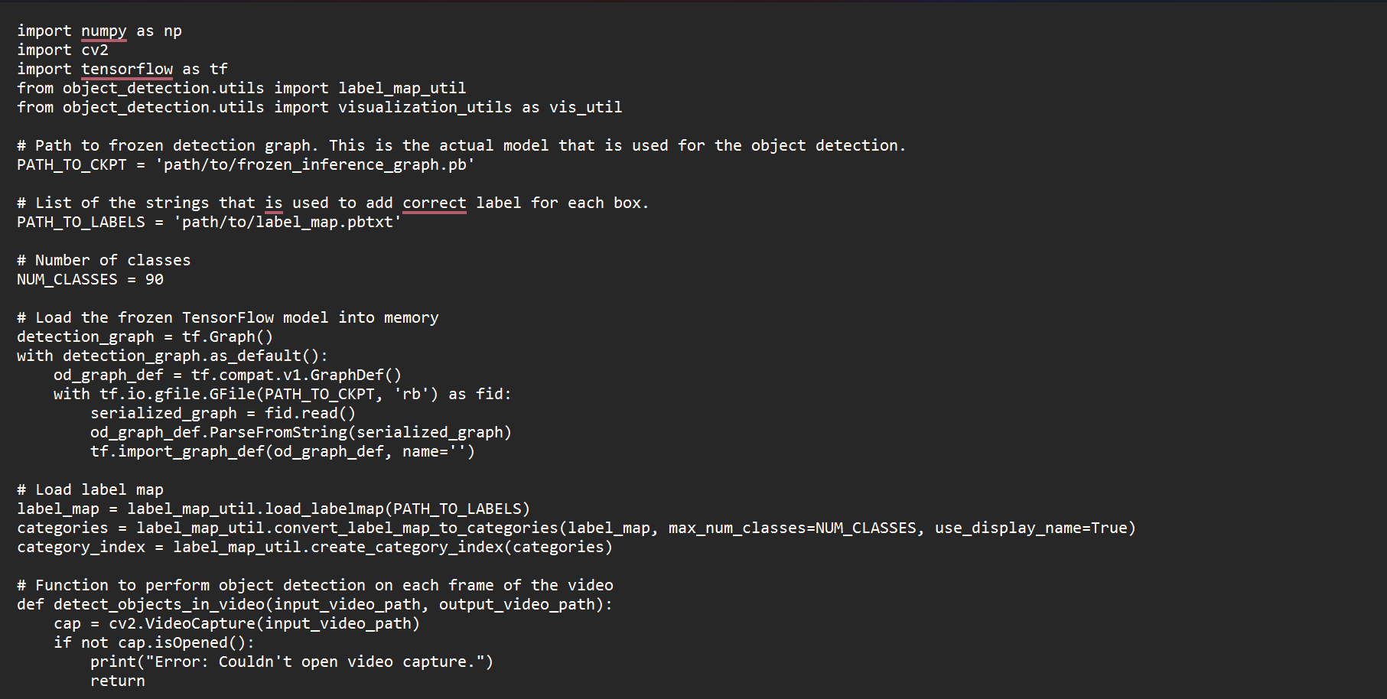
ALGORITHM

Slide 11
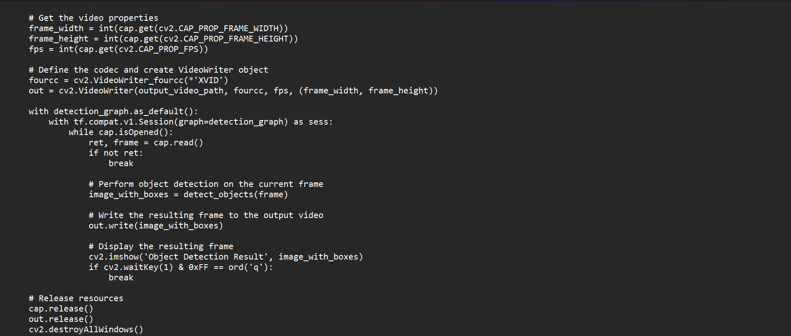
ALGORITHM

Slide 12
PROPOSED OUTCOME(S)
TO LOCATE THE RIOT OCCURRING PLACE AND DROP THE LETHAL WEAPON LIKE TEAR GAS

Slide 13
INDIVIDUAL CONTRIBUTIONS – D VISHAAL (21BRS1173)
Misson planning for autonomous flight of drone in QGroundControl.
RC remote calibration.
Preparation Review 1 (DA1) powerpoint presentation.

Slide 14
INDIVIDUAL CONTRIBUTION – SRINATH(21BRS1224)
Drone assembly and calibration.
Circuit design and implementation for the opening and closing mechanism of the tear gas dropper.

Slide 15
INDIVIDUAL CONTRIBUTION – N ANIRUDDHAN (21BRS1682)
1. Preparation of Review 2 (DA2) PowerPoint presentation.
Acquiring circuit components.
Preparation of Simulink real-time simulation of the project.

Slide 16
THANK YOU

